Slide 1
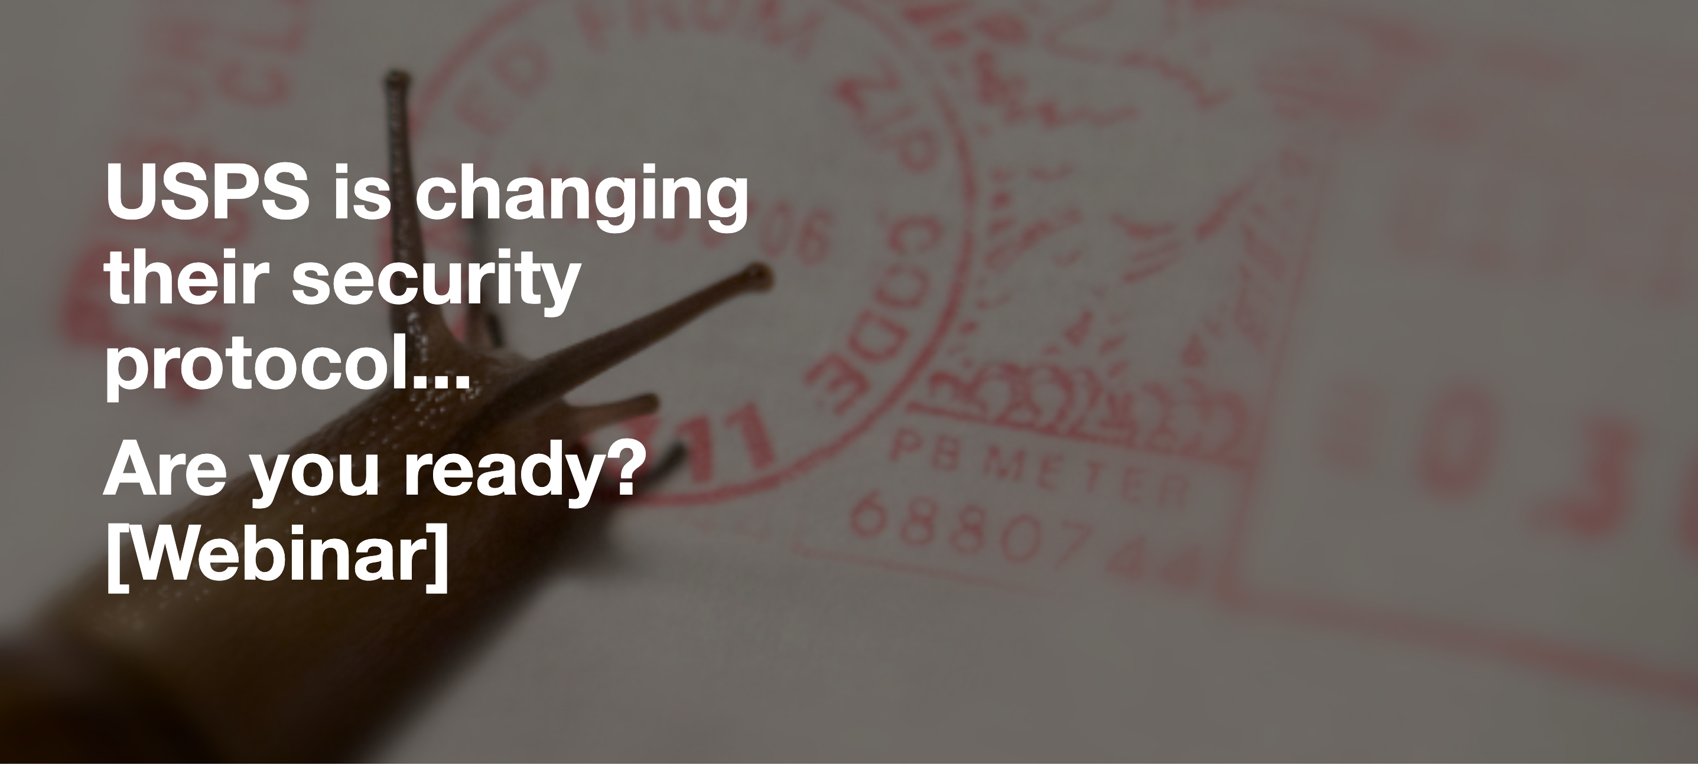
Welcome

Slide 2
Presenters
Rob Meachum Regional Sales Manager FP Mailing Solutions
Phil Landriault National Product Sales Manager - Mailing FP Mailing Solutions
Scott Anderson Imaging Sales Solutions Manager Loffler Companies
Notes:
My name is Anthony Rocheford and I manage the Physical Security Practice for Loffler Companies. I have been in this industry for more than 20 years and have an extensive background in technology ranging from
Video
Unified Communications
Access Control
IT HVAC
Digital Signage

Slide 3
To decertify is to withdraw or revoke the certification of
What this means to you is; as technology changes, specifically in the Postal industry, the USPS® (United States Postal Service) requires that all Postage Meters must conform to the new technology requirements. Roughly 95% of all Postage Meters in the US. that do not have the new technology MUST be removed from service by December 31, 2024

Slide 4
How does this Decertification effect YOU?
While this is a mandatory USPS change, there are some benefits for you!
Upgraded technology – With new technology comes new features
Why consider changing sooner rather than later - This is the largest Decertification in history!
What happens if I don’t change?

Slide 5
What is specifically changing
 | IBI (Information Based Indicia) | IMI (Intelligent Mail Indicia)
Security Standard | FIPS 140-1, Level 3 | FIPS 140-2, Level 3
Security Strength | 80 bits | 112 bits
Data Upload | Postage Download or 90 days | Daily
Lockout | 90 day watchdog timer | 45 day watchdog
 |  | Plus 72 hour tea timer
Connectivity | Analog & LAN | LAN only
Transactional Data Detail | No | Yes
Secured Data Storage on Meter | No | Yes
Printable Withdrawal Receipt w/Barcode | No | Yes
Key in Postage | Yes | No, only correction
Omit Date | Yes | Only for Reply Mail
100% Postal Rate Compliance at Rate Change | No | Yes

Slide 6
“I’ve got plenty of time to change”
This is the largest Decertification in history
There are over 847,000 postage meters that need to be removed from service and upgraded to IMI by December 31, 2024
That means over 1,000 customers have to be upgraded every day!
There are roughly 22,000 postage meters in Loffler’s coverage area

Slide 7
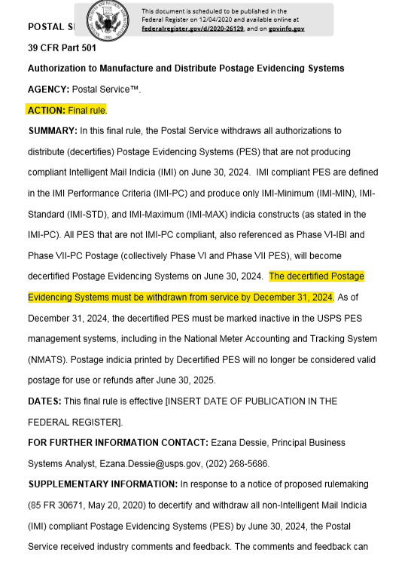
USPS Federal Register
https://www.federalregister.gov/documents/2020/12/04/2020-26129/authorization-to-manufacture-and-distribute-postage-evidencing-systems

Slide 8
Office Automation
For many, our “new normal” is fewer administrative workers & a more dispersed workforce
Additionally, it’s common that those who are still working in the office 8-5 are supervisors & managers
Lots of hats, too few heads to put them on
Risks of not automating

Slide 9
What can you do about it?
Make it easier on those wearing those extra hats
Office mail doesn’t seem like a big deal at face value
Have you ever had to run your postage meter?
What about your folder/inserter?
Do you even know folder/inserters are a “thing”?
How long does it take to process your mail?
There are no “soft costs” in postage rates
Are you paying 47+% more than you should be?
What is the value of your mail?

Slide 10
Mail Automation

Slide 11
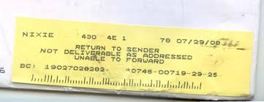
What you don’t know does cost you
There are no “soft costs” in postage rates
Are you paying 47+% more than you should be?
What is the value of your mail?
If it wasn’t a key business document that drives your business, you’d email it
Invoice, statement, marketing piece, non-profit fund raiser, financial report, healthcare
This is NOT your friend!

Slide 12
Mail Process Review
Have you ever had a Mail Process Review?
If you were to answer questions about your current mail process with “we’ve always done it that way” or “that’s how I was taught when I started”…
A 10,000 foot analysis of your current mail process from a person looking through a forensic lens to find ways to automate & reduce costs
Benefits of this review
Compliance
Security
Automation
Cost reduction
You’ll be a better informed decision maker going forward
It’s FREE to you!

Slide 13
Q&A

